Slide 1




Pet Club
http://petclub.iat.net.cn/
Shanliang Yao
1930954

Slide 2



Contents
03
Social Media
01
04
Introduction
Implementation
02
System Design
05
Web pages
06
Discussion

Slide 3

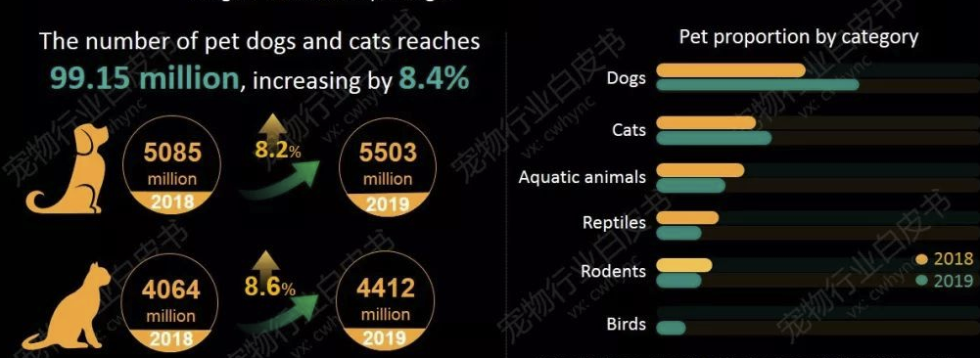
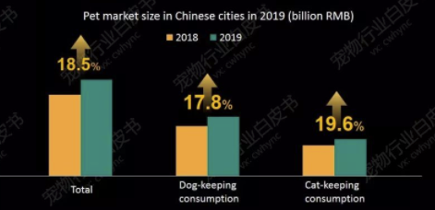

Introduction
According to the “2019 White Paper on China’s Pet Industry”, China’s urban pet consumption scale reached 202.4 billion RMB, an increase of 18.5% over 2018. It is estimated that by 2023, the scale of China’s pet consumption market will reach 472.3 billion RMB.
2020/05/29

Slide 4
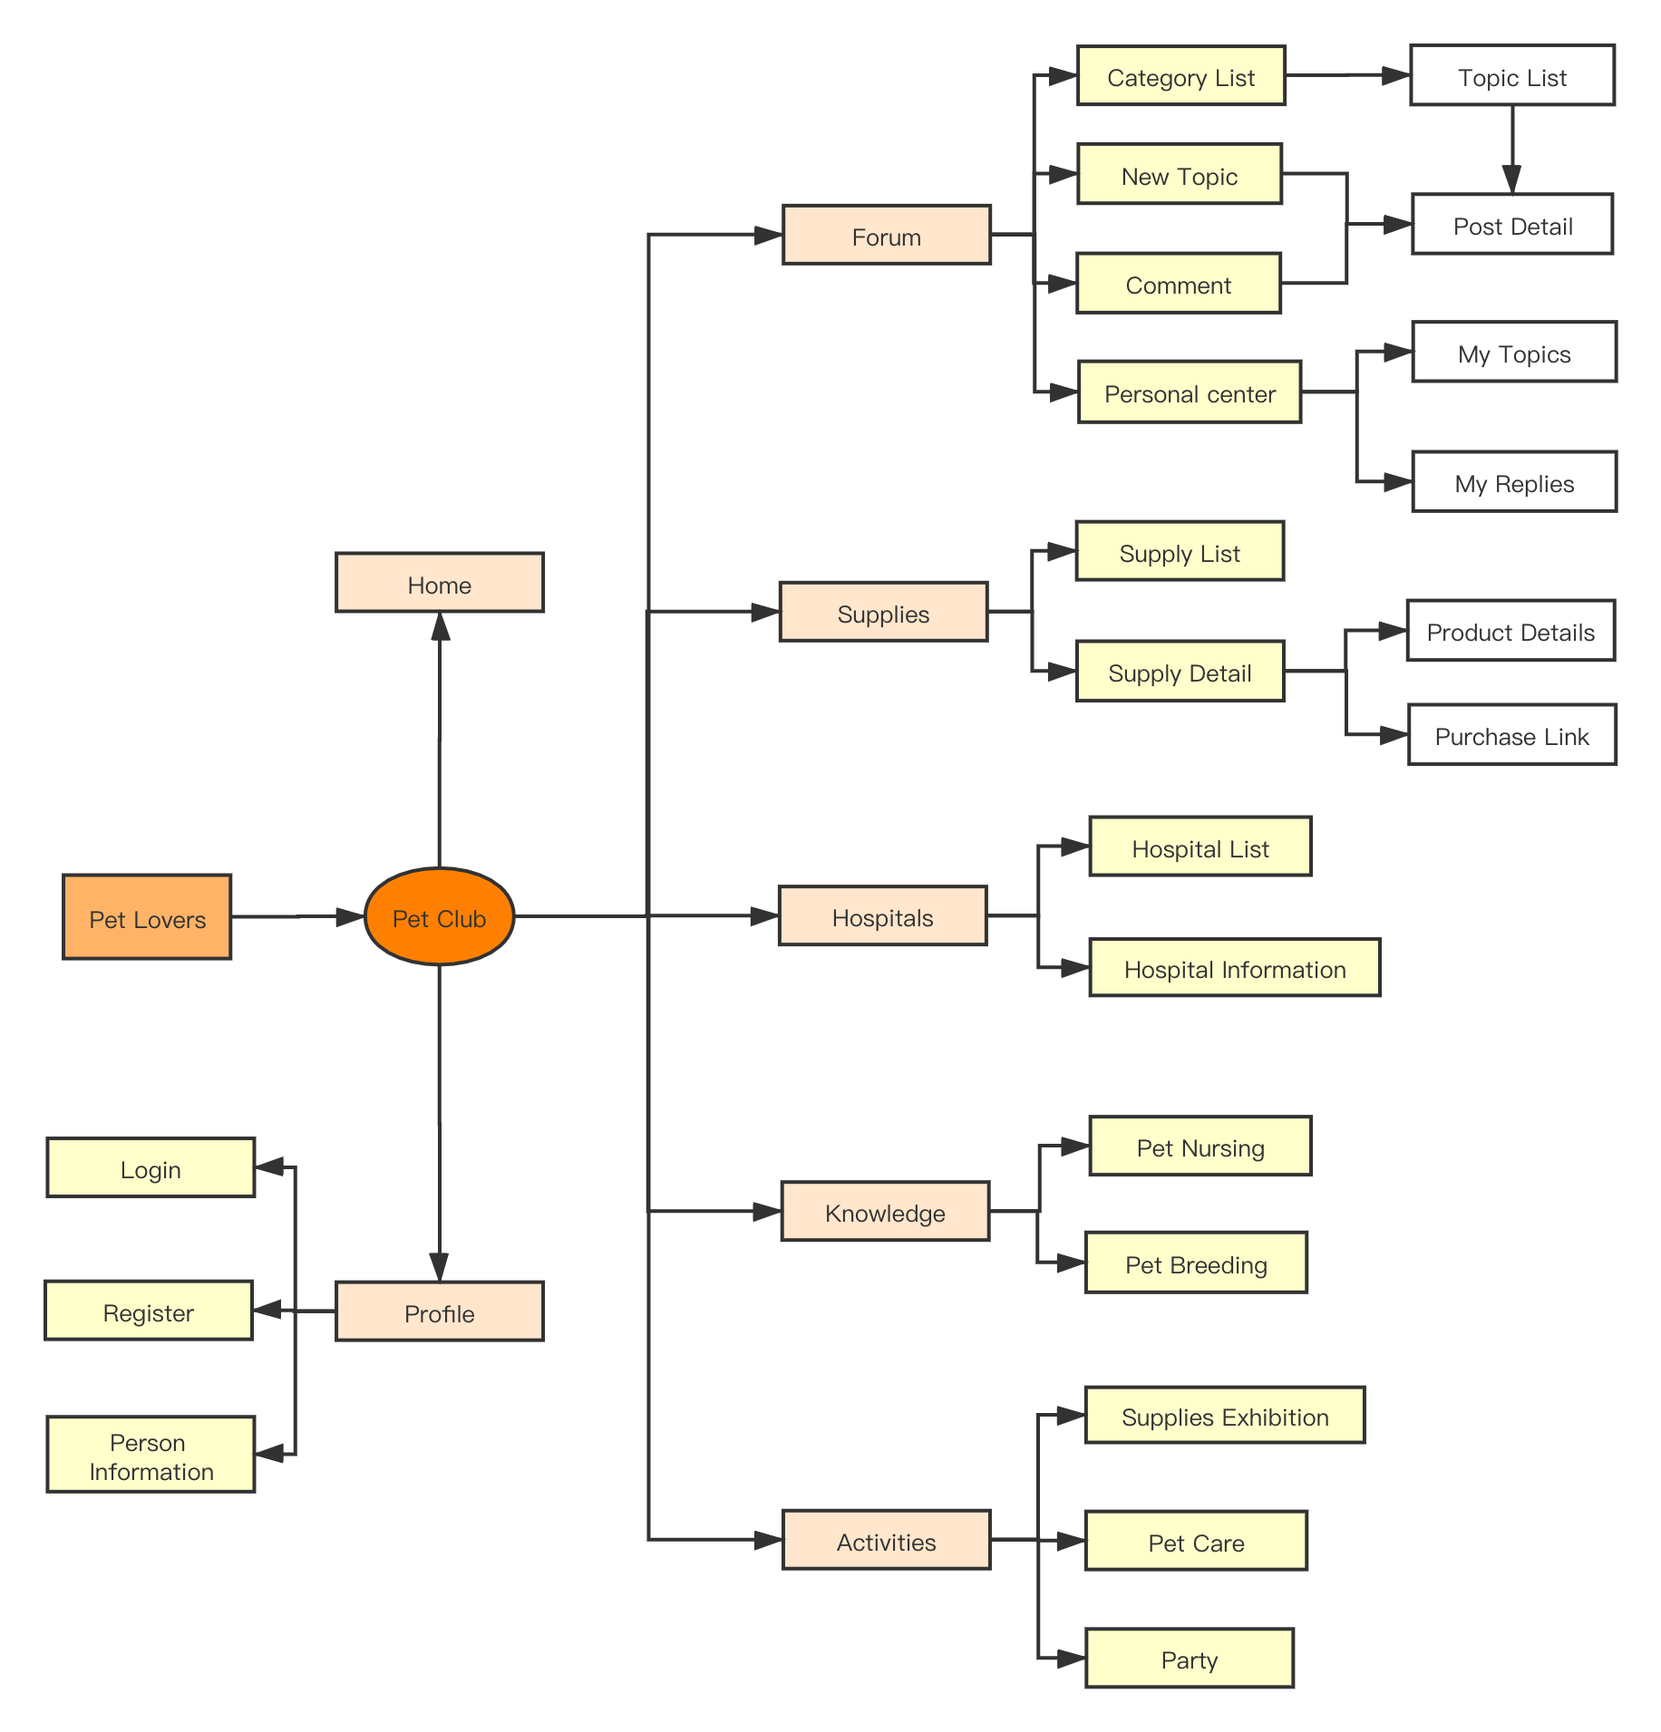
System Design
01
02
Forum
Supplies
Share texts, photos, and videos
Provide reliable products for users
05
Activities
Attend pet supplies exhibitions and offline parties
03
Hospitals
04
Knowledge
Easy for users to find nearby hospitals
Provide professional knowledge for users to learn
2020/05/29

Slide 5

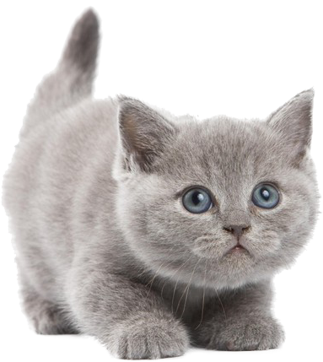
Social Website
Type of social media
Media sharing networks
In social websites, after the user creates an account, he can make new friends, even with friends of friends, keep in touch with friends who have not been in contact for a long time, or stay in touch with friends of different cultures and religious beliefs.
Supplies
Hospitals
Discussion forums
Forum
Interest-based networks
Knowledge
Activities
2020/05/29

Slide 6
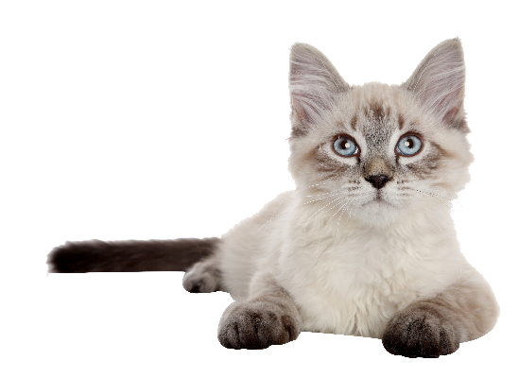
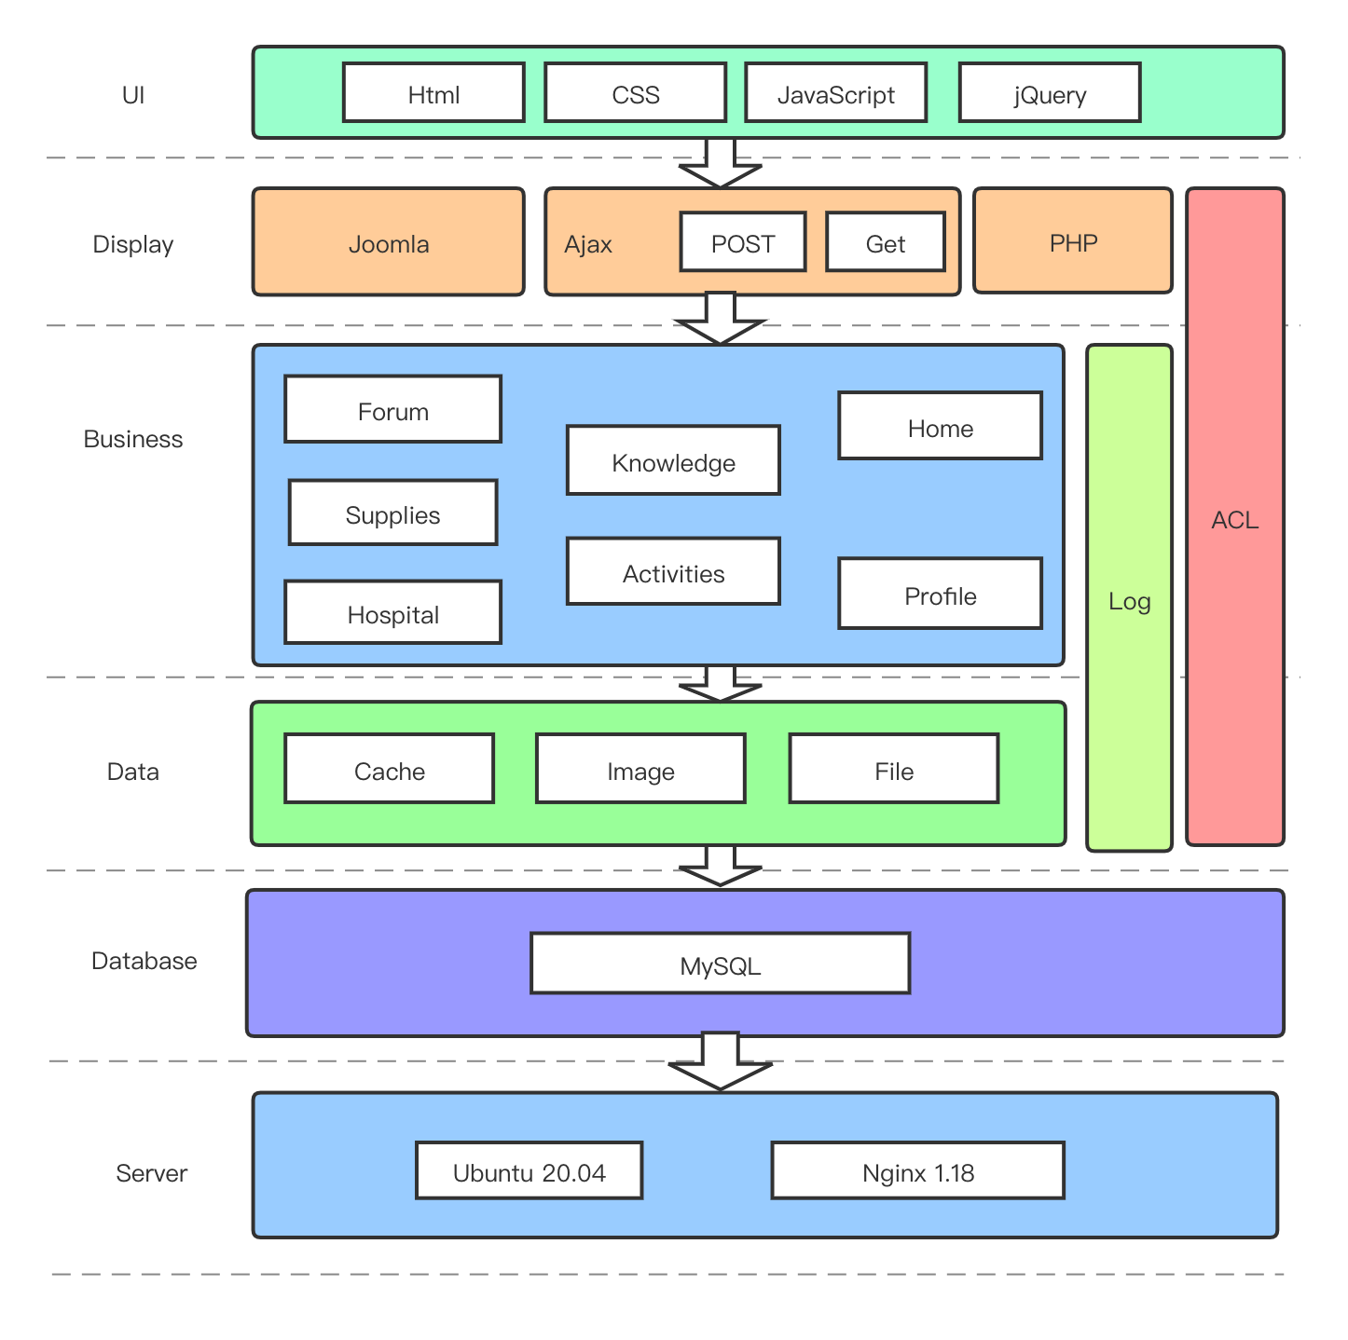

Software Architecture
HTML, JavaScript, CSS, jQuery, PHP, MySQL
Joomla
2020/05/29

Slide 7
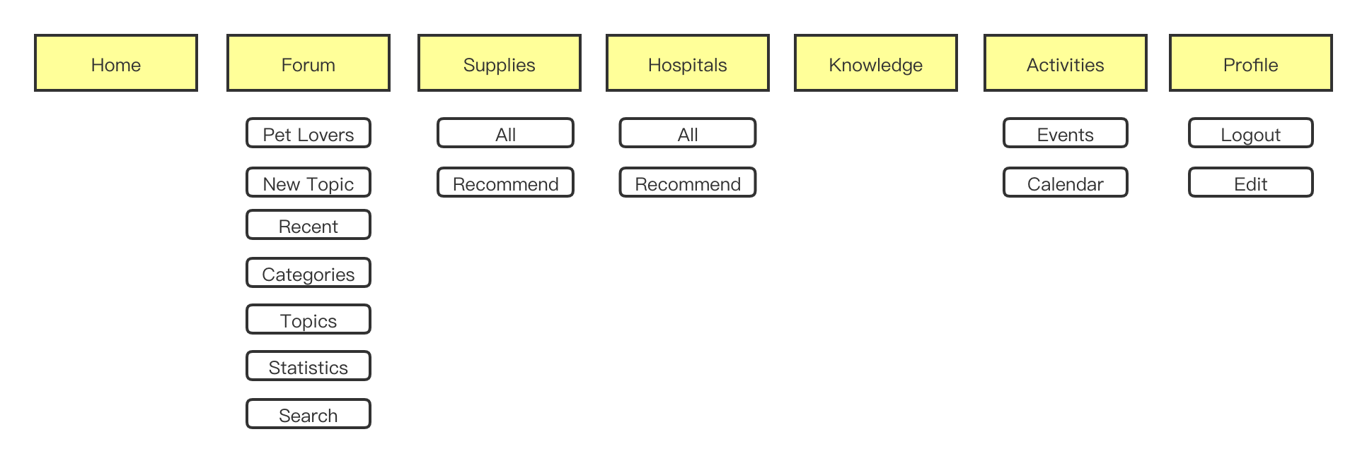

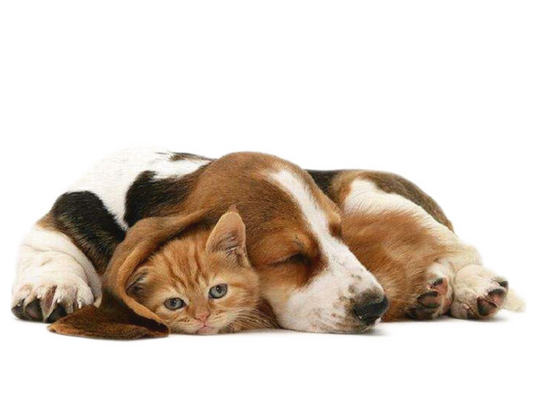
Menu
2020/05/29

Slide 8

Template and Extensions
Powerpoint Templet
Kunena Forum
I added a user list page to be able to directly view posts from a user
Joomla, which is a popular social networking framework with various themes and plugins
Powerpoint Templet
JEvent
Powerpoint Templet
I modified the style of buttons and layout to make it consistent with the overall style of the website.
Protostar
Powerpoint Templet
JWpagefactory
I modified the width of the template so that it can adapt to the size of different browsers
I created a homepage, a hospital page, a user page, modified some styles, and added some pictures
2020/05/29

Slide 9
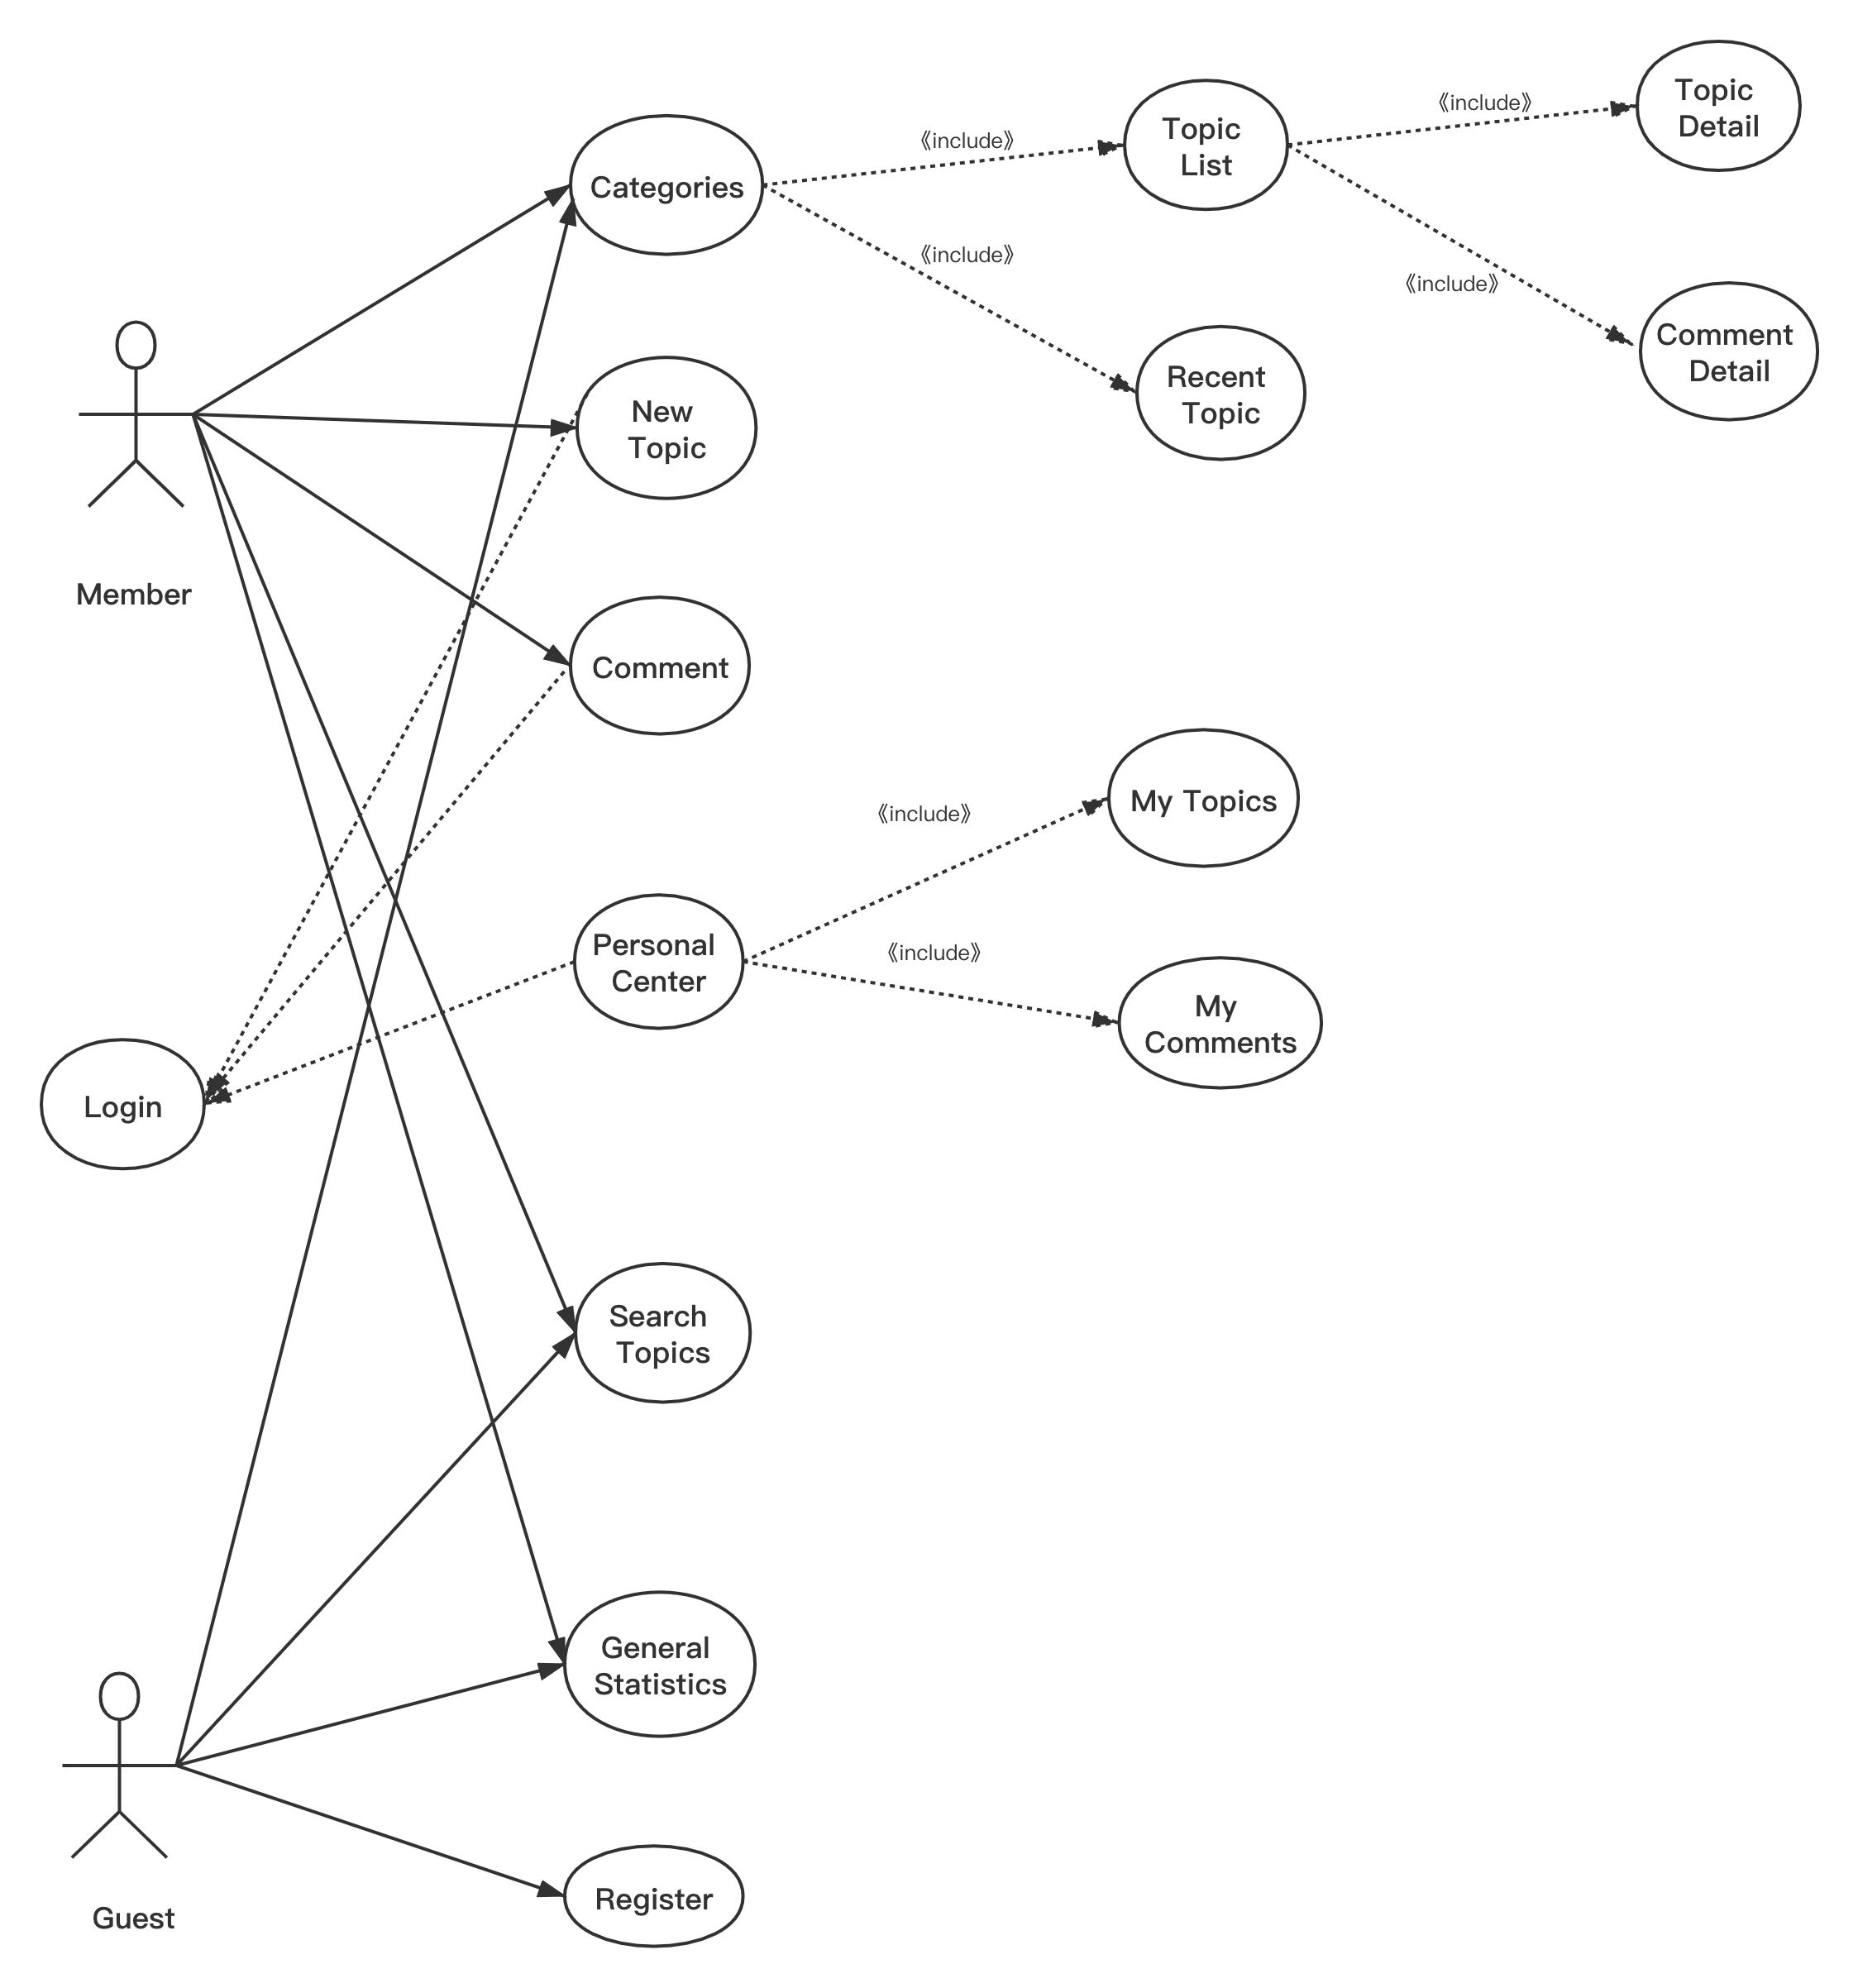
Testing - Use Case
2020/05/29

Slide 10


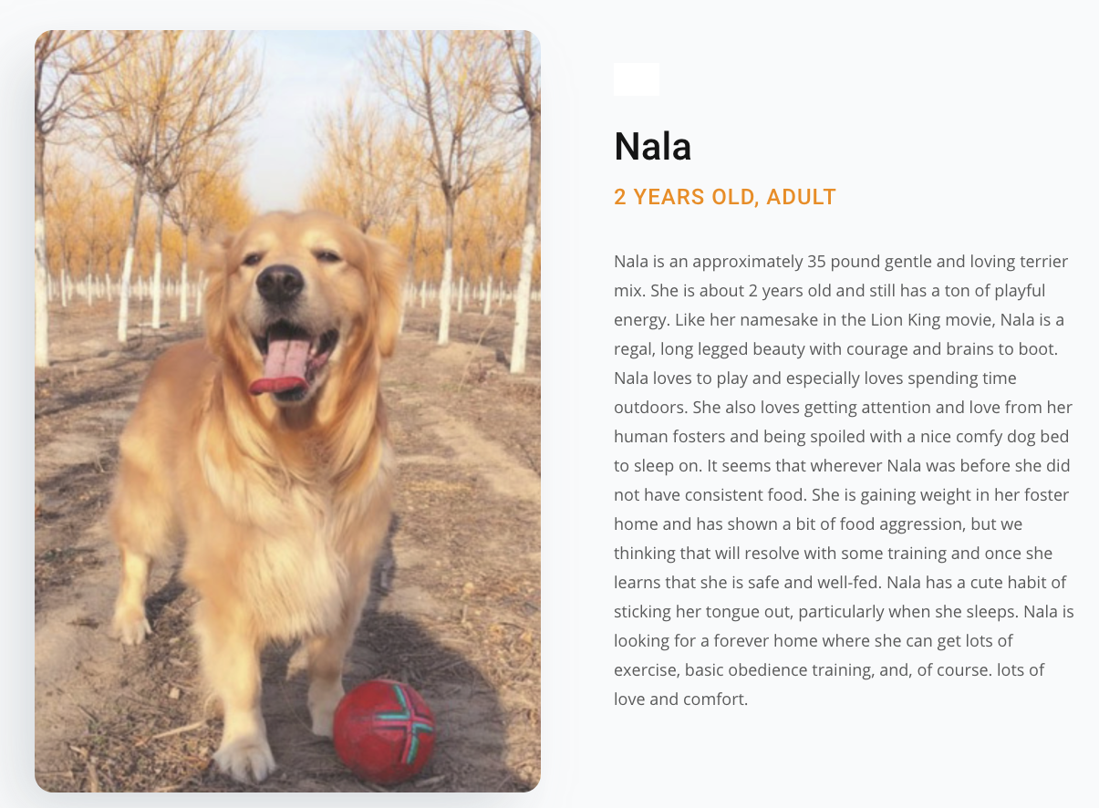
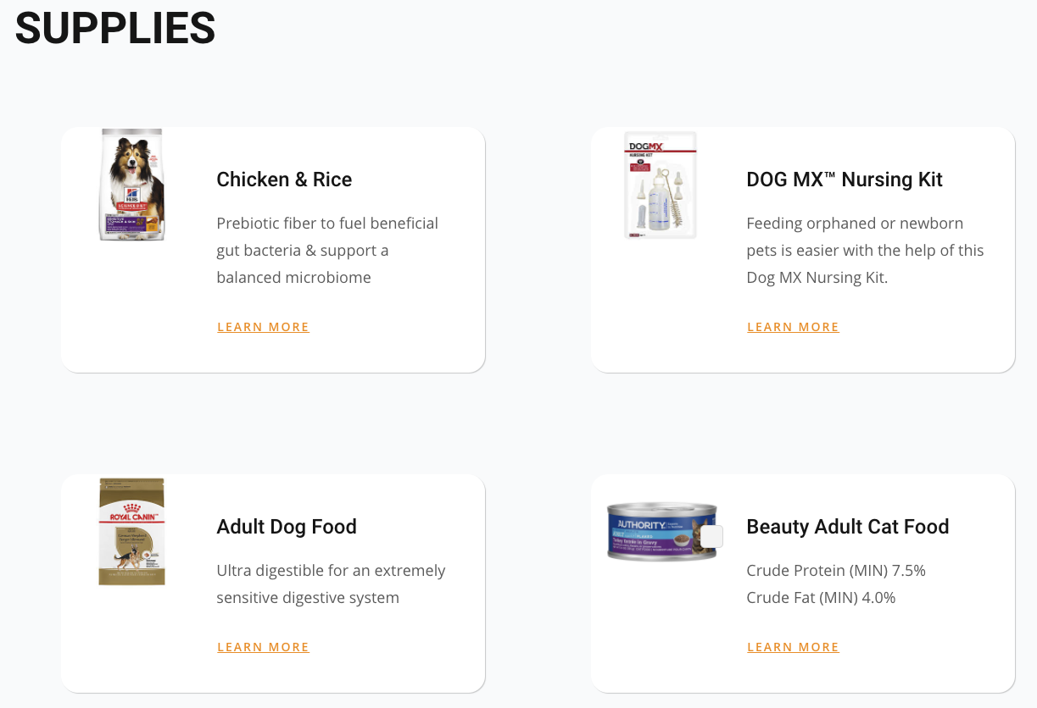
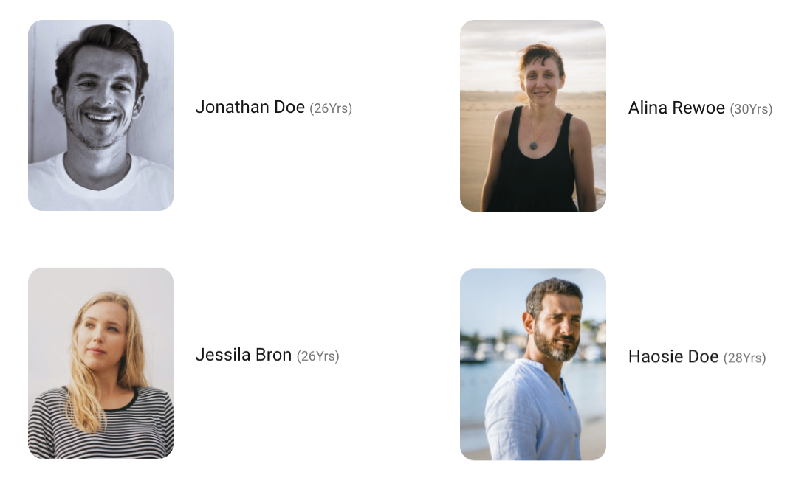
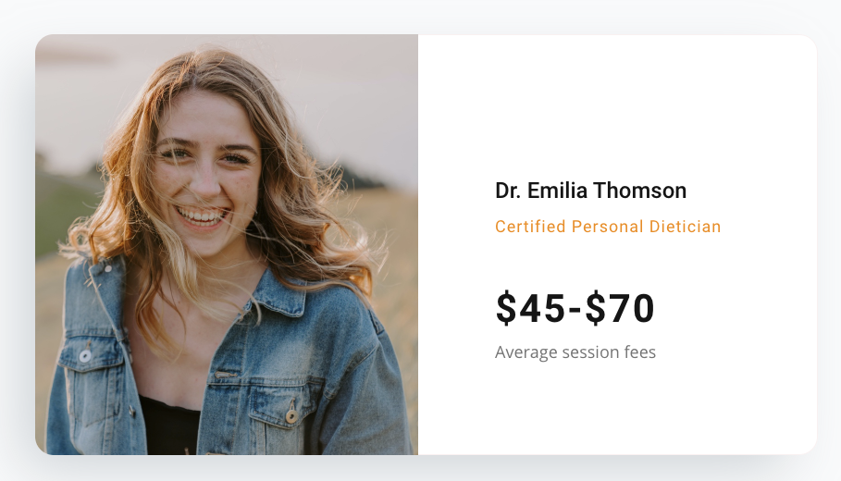
Web Pages
2020/05/29

Slide 11
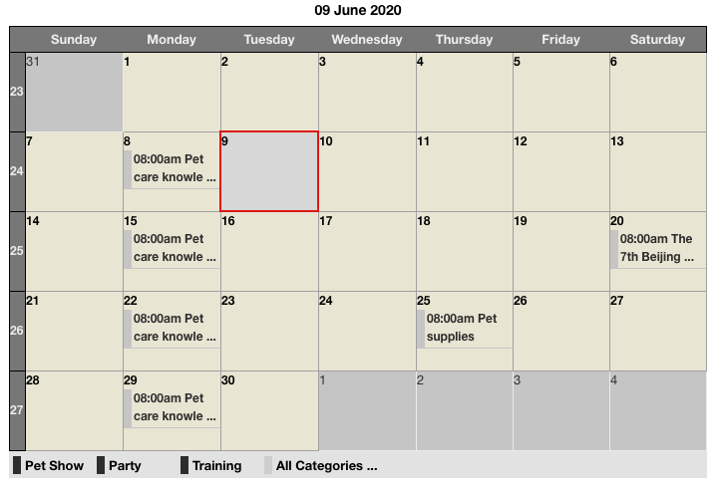
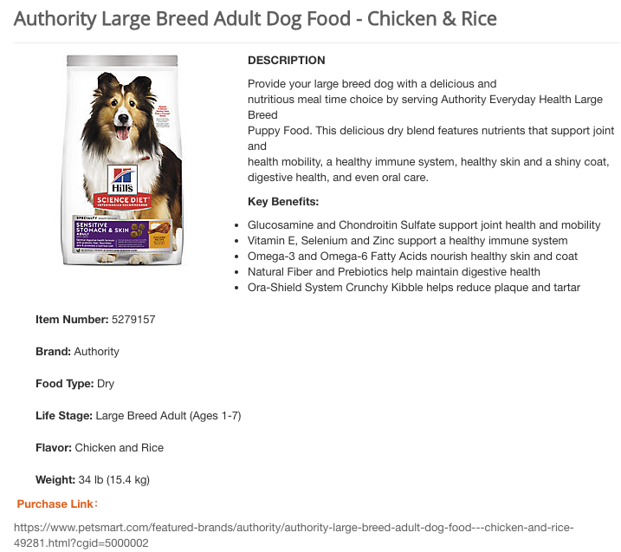
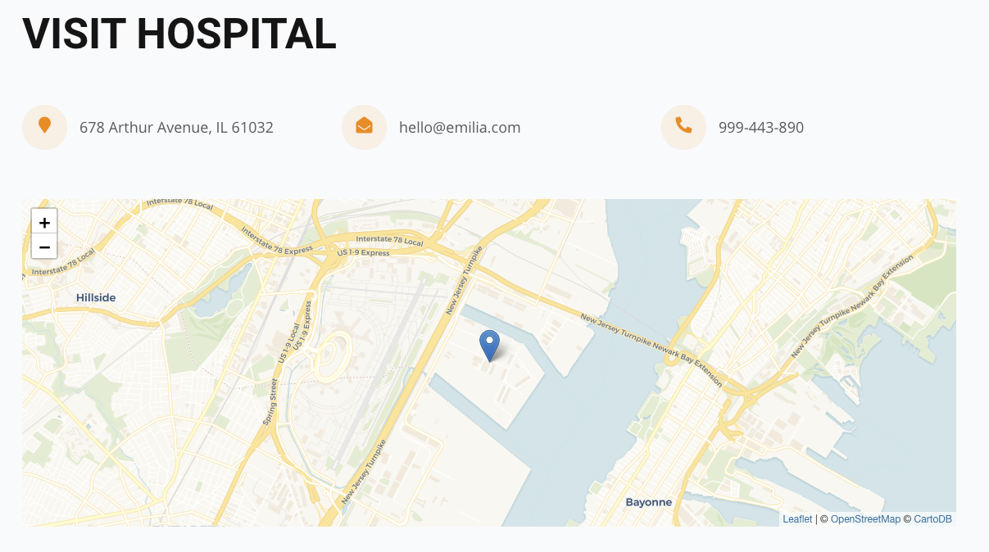
Website Pages
2020/05/29

Slide 12
Critical Review
Limitations
Strength
Website design needs to be improved
Website features need to be enriched
Need to add more login methods, such as WeChat, Weibo, Facebook, etc.
Provide a platform for users to communicate and share pet stories
Provide reliable pet hospital information
Provide users with high-quality pet supplies
Organize regular events to promote friendship among members
Share professional pet care knowledge
Promote the development of the pet industry
2020/05/29

Slide 13
Optimize CSS styles to improve the beauty of the website
Research more Joomla extensions to apply to the website
Continue learning PHP and web knowledge deeply
Read more literature to study the development of this industry
Do more market research to collect user needs
Future Work
HTML, JavaScript, CSS, jQuery, PHP, MySQL
Joomla
2020/05/29

Slide 14
Pet Club
Thank You
Demonstration →
http://petclub.iat.net.cn/

